Slide 1
Trigonometry Lesson 7 Cosine Law
© Copyright all rights reserved to Homework depot: www.BCMath.ca

Slide 2
I) What is the Cosine Law
The Cosine Law is for solving triangles that are NOT R.T.
You could only use the Cosine Law when you have:
2 sides and the angle in between
All 3 sides and need to find the angles
Finding side “a” or angle A
Finding side “b” or angle B
Finding side “c” or angle C
© Copyright all rights reserved to Homework depot: www.BCMath.ca

Slide 3
EX: FIND THE VALUE OF THE MISSING SIDE “X”
Indicate which side you want to find
Indicate which side you want to find
Plug the values into your formula
Plug the values into your formula
© Copyright all rights reserved to Homework depot: www.BCMath.ca

Slide 4
II) FINDING ANGLES WITH THE COSINE LAW
When finding angles, isolate the cosine function first
Then use inverse cosine to find the angle
The side opposite of the angle must be on the left of the equation
Indicate which side you want to find
Plug the values into your formula
© Copyright all rights reserved to Homework depot: www.BCMath.ca

Slide 5
Practice: Find the missing angle

Slide 6
Practice: Find the missing angle
Indicate which side you want to find
Plug the values into your formula
© Copyright all rights reserved to Homework depot: www.BCMath.ca

Slide 7
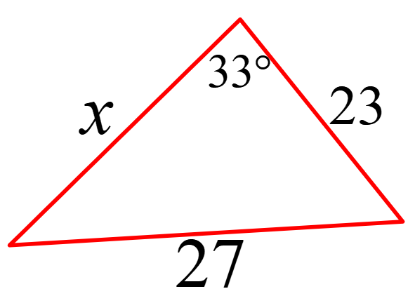
When do you use Sine Law vs Cosine Law?
The sine law can only be used when you have an angle with the opposite side
Cosine Law can be used when you have SSS, SAS, SSA
Q: Indicate which law you would use to solve for the missing value:

Slide 8
Ex: Use the cosine Law to find the length of the missing side:

Slide 9
Practice: FIND THE AREA OF THE TRIANGLE
Find one of the angles
Use the angle to find the height of the triangle
© Copyright all rights reserved to Homework depot: www.BCMath.ca

Slide 10
Proof For the Cosine Law
© Copyright all rights reserved to Homework depot: www.BCMath.ca

